Slide 1

Smart security system
Group no:2
Sreehari.p
Joseph Mel Joel
Abin Saji
Linto lalichan

Slide 2
SMART SECURITY SYSTEM
The smart security system is an automated security system which alerts the officials when an unauthorised access is made into any restricted areas or facility
When motion is detected by the ultrasonic sensor the system will turn on all the lights , warns the official by firing up siren and locks the door of the facility so that the intruders will be trapped inside them

Slide 3
COMPONENTS USED
ARDUINO UNO
LED
BUZZER
SERVO MOTOR
BREAD BOARD
HC-SR04 ULTRASONIC SENSOR
Jumber wire

Slide 4
Objective
The aim of the project smart security system is to develop a smart system that can detect and alert user about any unauthorised access in real time.
The system utilises a range of sensors and output devices to alert the officials regarding the unauthorised access
The system is also designed to be scaled and customisable allowing users to add or remove sensors and output devices based on their specific security needs.

Slide 5
SCOPE
1: Home security : The security system can be used in homes to provide an effective and reliable solution for ensuring the safety and security of residents
2: Office security: the system can be used in offices to monitor access to restricted areas, detect potential security threats and alert the security personnel in real-time
3: public places: the smart security system can be used in public places such as parks, museum and shopping centres to monitor activity and ensure the safety of visitors
4: industrial security: the system can be used in industrial settings to monitor access to restricted areas, detect potential security threats and prevent theft or vandalism

Slide 6
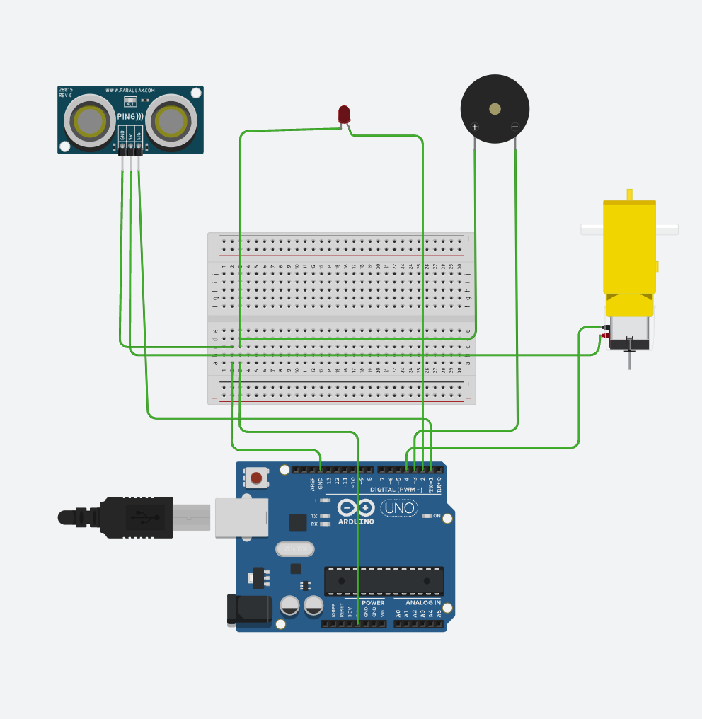
Circuit diagram

Slide 7
Arduino IDE
The Arduino IDE is an open-source software, which is used to write and upload code to the Arduino boards. The IDE application is suitable for different operating systems such as Windows, Mac OS X, and Linux. It supports the programming languages C and C++. Here, IDE stands for Integrated Development Environment.
The program or code written in the Arduino IDE is often called as sketching. We need to connect the Genuino and Arduino board with the IDE to upload the sketch written in the Arduino IDE software. The sketch is saved with the extension '.ino.'

Slide 8
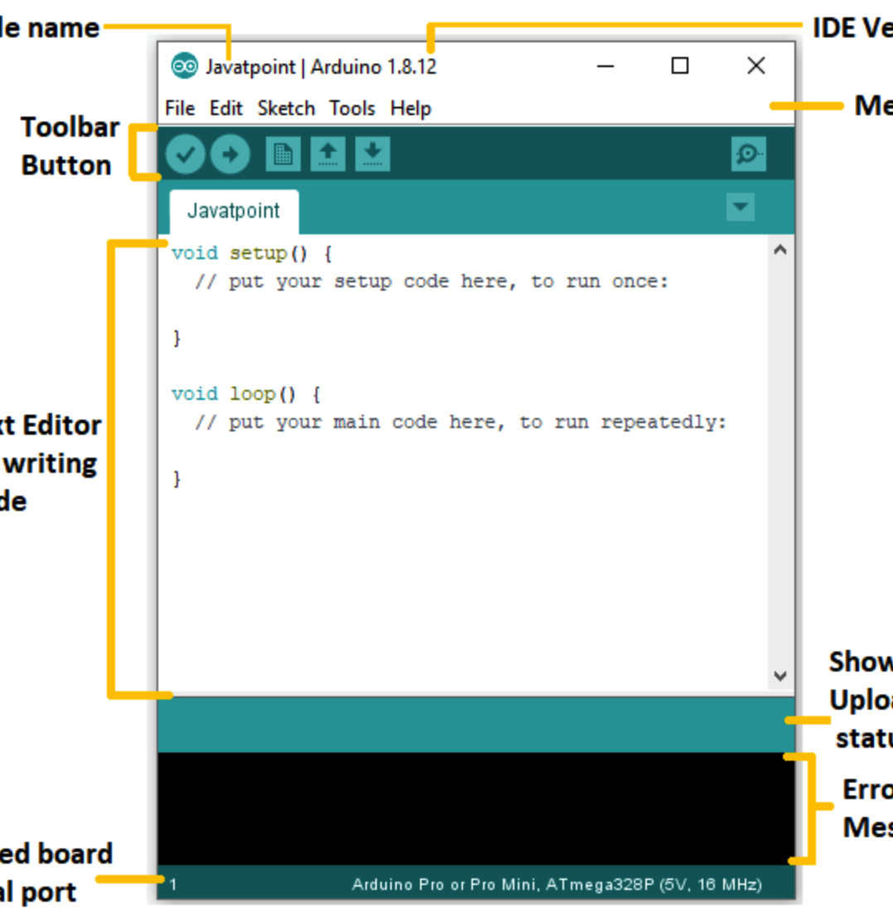
Arduino IDE

Slide 9
.
The Arduino IDE has two bulid in functions: void setup() ,and void loop()
Void setup()
Void setup function is used to set the input and output devices associated with Arduino we use pin mode function to assign each pin to external devices along with output,input to specify the connected device is for input or output

Slide 10
.
Void loop()
Void loop function is used to repeat a set of code until the Arduino is turned off. The code given inside void loop will repeat number of times
We use delay() to stop executing the code for a particular time

Slide 11
CODE
#define trigPin 6 //Define the HC-SE04 triger on pin 6 on the arduino
#define echoPin 5 //Define the HC-SE04 echo on pin 5 on the arduino
#define bulb 13 //Define the relay signal on pin 9 on the arduino
#define buzzer 10
#define lock 11
#include <Servo.h>
int angle = 0;
Servo servo;
void setup()
{
Serial.begin (9600); //Start the serial monitor
pinMode(trigPin, OUTPUT); //set the trigpin to output
pinMode(echoPin, INPUT); //set the echopin to input
pinMode (bulb, OUTPUT); //set the bulb on pin 9 to output
servo.attach(lock);
pinMode (buzzer, OUTPUT); //set the bulb on pin 9 to output
}

Slide 12
CODE
void loop()
{
int duration, distance; //Define two intregers duration and distance to be used to save data
digitalWrite(trigPin, HIGH); //write a digital high to the trigpin to send out the pulse
delayMicroseconds(500); //wait half a millisecond
digitalWrite(trigPin, LOW); //turn off the trigpin
duration = pulseIn(echoPin, HIGH); //measure the time using pulsein when the echo receives a signal set it to high
distance = (duration/2) / 29.1;
if (distance < 10) //if the distance is less than 13 CM
{
Light(); //execute the Light subroutine below
}
Serial.print(distance); //Dispaly the distance on the serial monitor
Serial.println(" CM"); //in centimeters
delay(500); //delay half a second
}

Slide 13
CODE
void Light() //Start the Light subroutine
{ digitalWrite(bulb, HIGH); //turn on the light
servo.write(180); // set the servo angle
delay(15); // wait for the servo to move
tone(buzzer, 100);
delay(5000);
noTone(buzzer);
delay(1000);
digitalWrite(lock, HIGH); //turn on the light
delay (3000); //wait 15 seconds
digitalWrite(bulb, LOW); //turn off the light
digitalWrite(buzzer, LOW); //turn off the light
digitalWrite(lock, LOW); //turn off the light
}

Slide 14
LIMITATION
. Power Limitations
. Security Vulnerabilities
. User Interface Limitations
. Limited Processing Power
. Limited Memory

Slide 15
Conclusion
In conclusion, a smart security system using Arduino presents a comprehensive and customizable solution for safeguarding homes and offices.
By integrating Arduino with various sensors, cameras, and alarms, it enables real-time monitoring, remote access, and automation capabilities. This system offers enhanced security through features such as motion detection,and intruder alerts.
Overall, a smart security system using Arduino provides affordability, versatility, and advanced functionalities for effective protection.

Slide 16
THANK YOU

